Slide 1
Probability

Slide 2
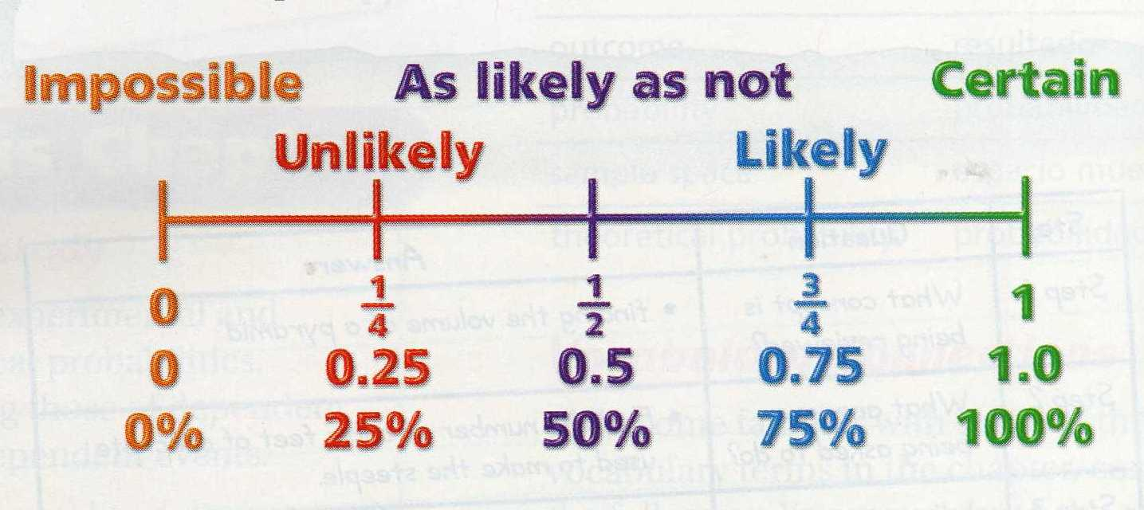
Probability: is the likelihood that an event will occur.
  Probability can be written as a fraction or decimal.
_______________
_______________
_______________

Slide 3
Probability is always between 0 and 1.
Probability = 0 means that the event will NEVER happen.
  Example: The probability that the Bills will win the Super Bowl this year.
Probability = 1 means the event will ALWAYS happen.
  Example: The probability that Christmas will be on December 25th next year.

Slide 4
Event: A set of one or more outcomes
  Example: Getting a heads when you toss the coin is the event
Compliment of an Event: The outcomes that are not the event
  Example: Probability of rolling a 4 = 1/6. Not rolling a 4 = 5/6.
Experiment: an activity involving chance, such as rolling a cube
  Tossing a coin is the experiment
Trial: Each repetition or observation of an experiment
  Each time you toss the coin is a trial

Slide 5
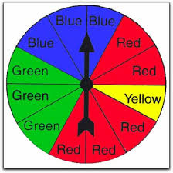
Outcome: A possible result of an event.
  Example: An outcome for flipping a coin is H
  Example: The list of all the outcomes for flipping a coin is {H, T}
Sample space: A list of all the possible outcomes.
  Example: The sample space for spinning the spinner below is:
  {B, B, B, R, R, R, R, R, Y, G, G, G}.

Slide 6
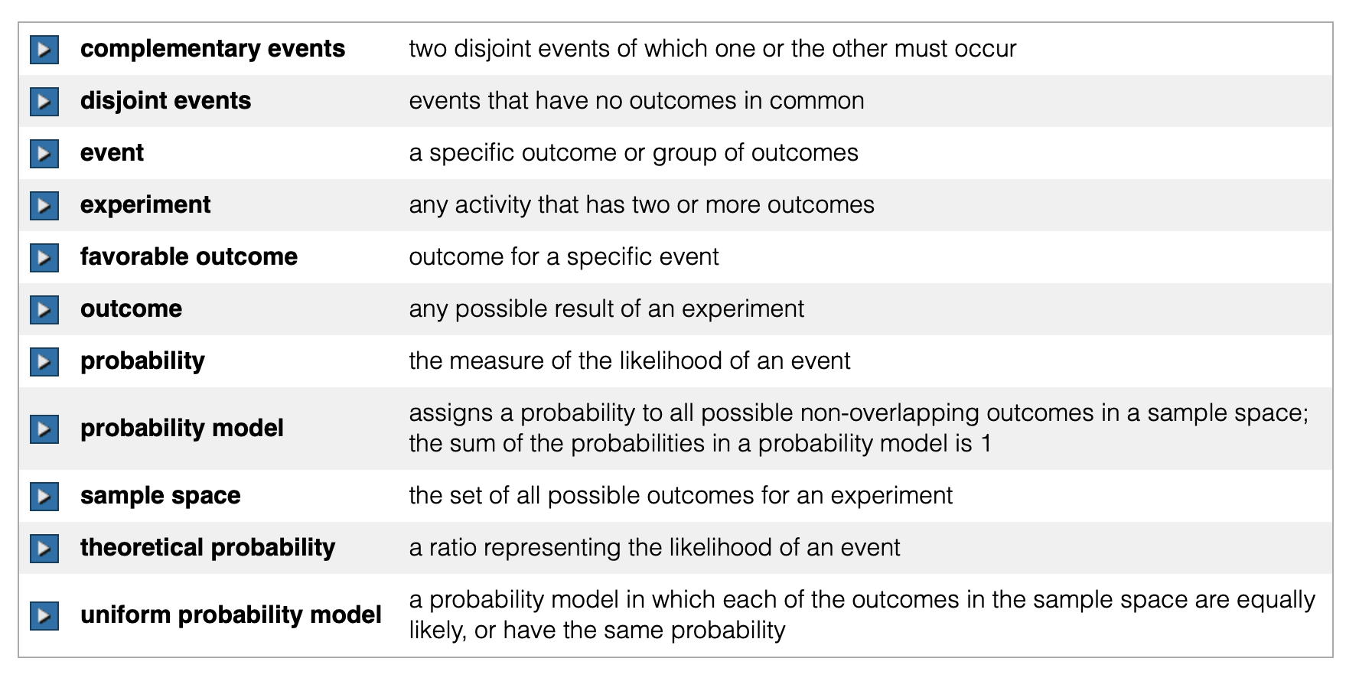

Slide 7
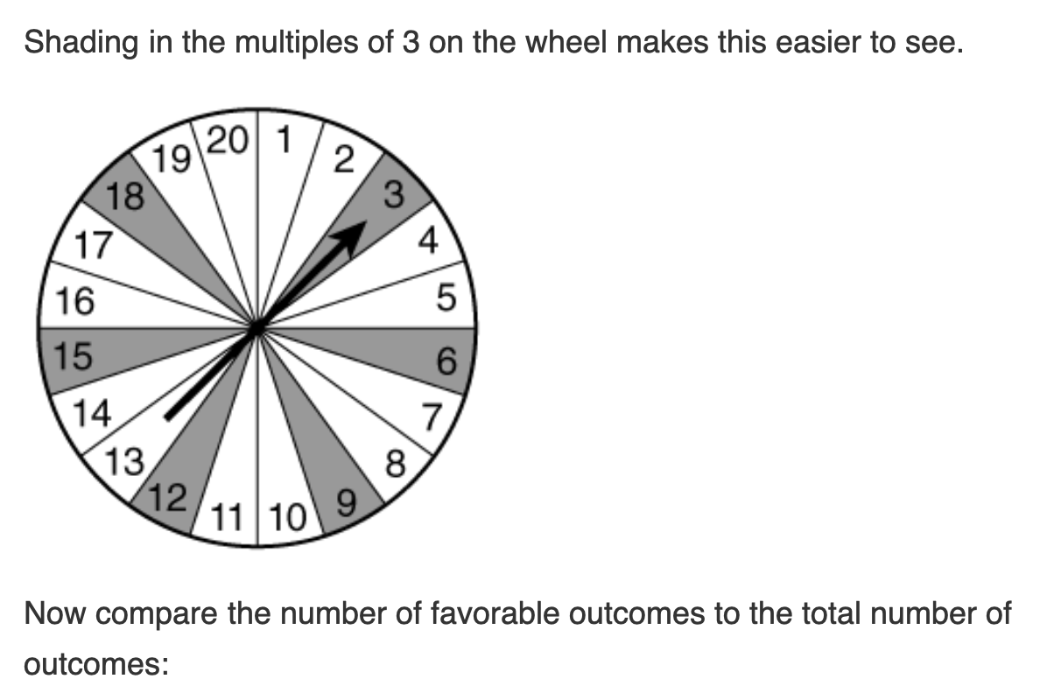
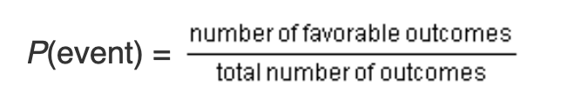
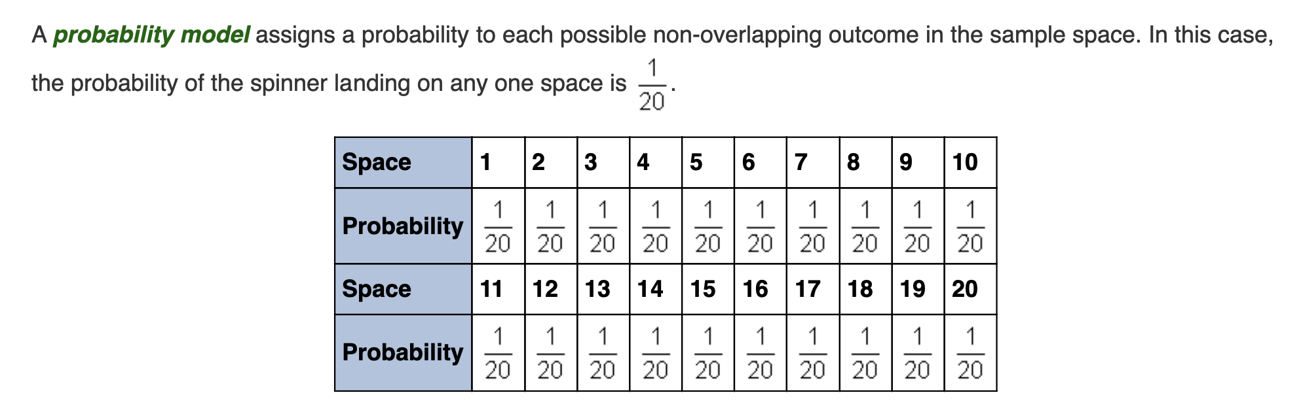

Slide 8
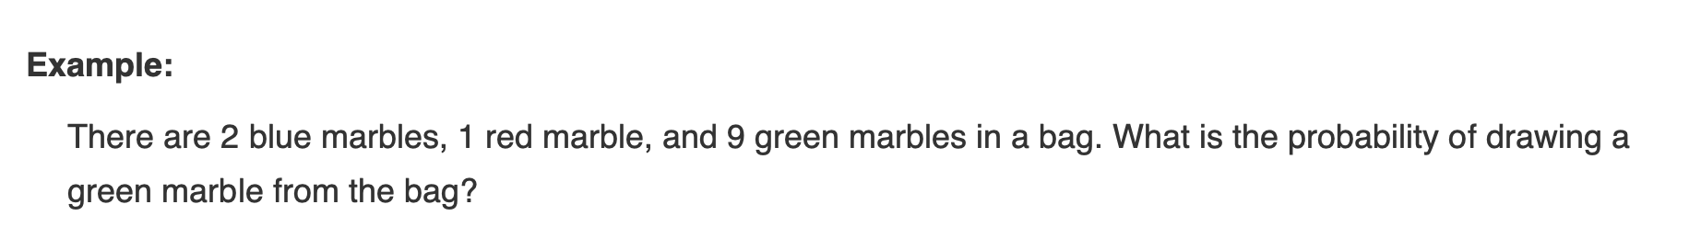
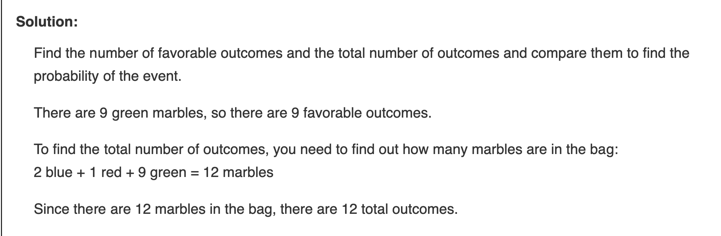
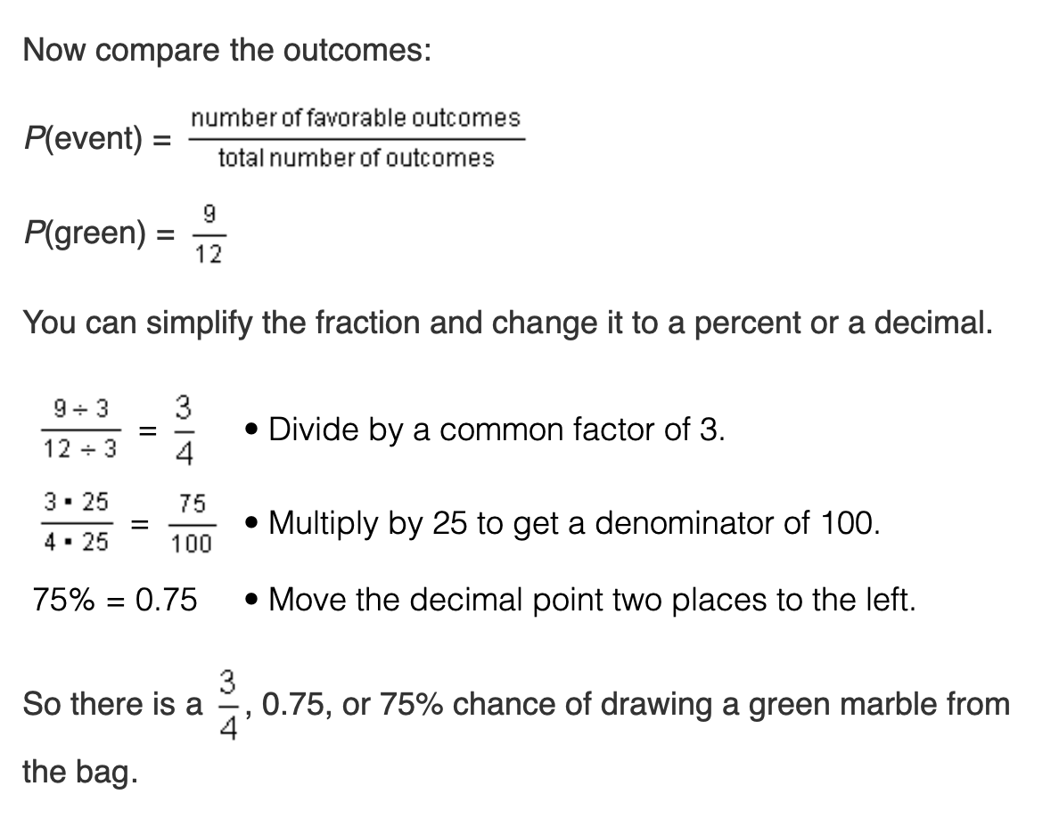

Slide 9
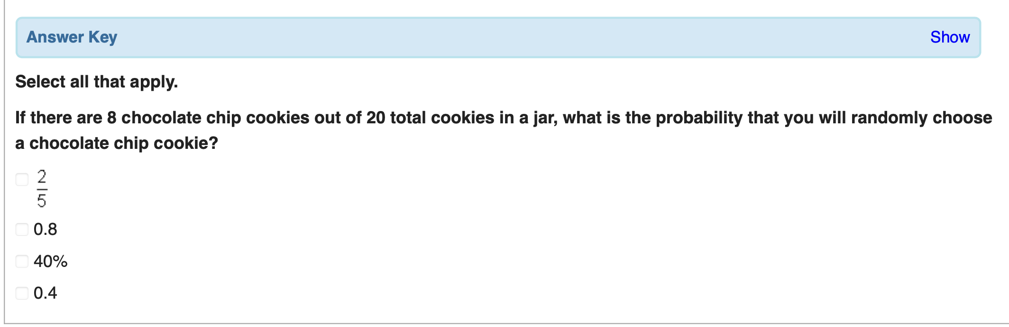
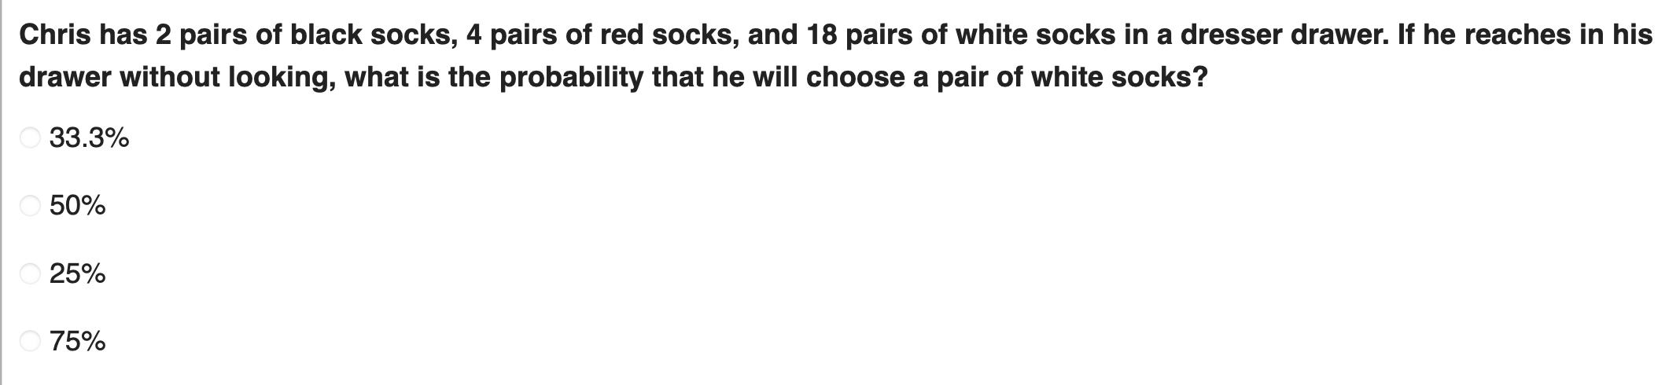
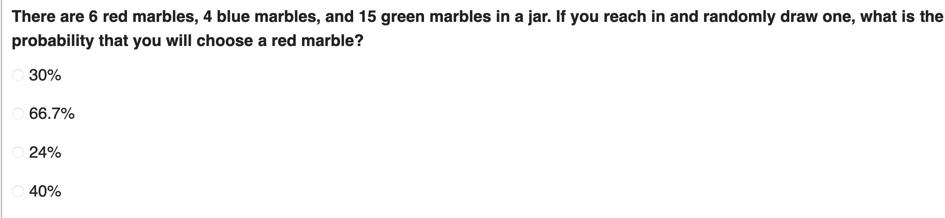

Slide 10
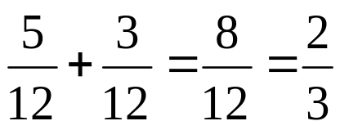
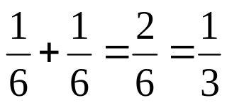
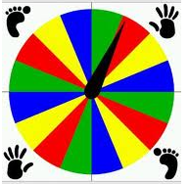


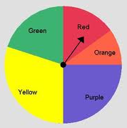
Calculating OR Probabilities: by adding the probabilities.
  Example: P (Red or Green) in the spinner
  Example: When rolling a die: P(3 or 4)
Uniform Probability: an event where all the outcomes are equally likely.
  Which spinners have uniform probability?
X
X

Slide 11

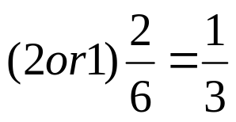
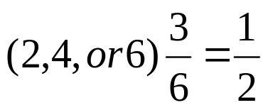
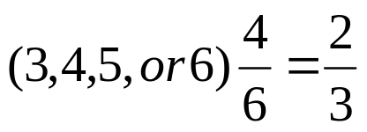
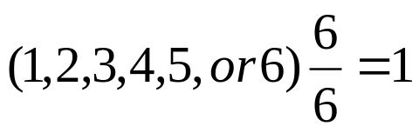
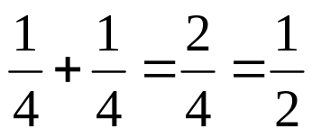
Calculating Probabilities
Rolling a 0 on a number cube
Rolling a number less than 3 on a number cube
Rolling an even number on a number cube
Rolling a number greater than 2 on a number cube
Rolling a number less than 7 on a number cube
Spinning red or green on a spinner that has 4 sections (1 red, 1green, 1 blue, 1 yellow)

Slide 12
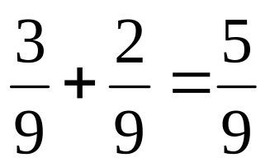
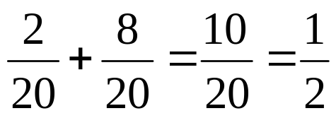
Calculating Probabilities Contd
Drawing a black marble or a red marble from a bag that contains 4 white, 3 black, and 2 red marbles.
Choosing either a number less than 3 or a number greater than 12 from a set of cards numbered 1 – 20.

Slide 13
Independent Practice

Slide 14





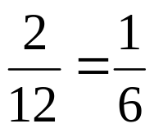
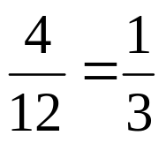
Write impossible, unlikely, equally likely, likely, or certain
It is _____________ to draw a striped pebble from the bag.
Drawing a white pebble from the bag is _________________.
Drawing a spotted pebble from the bag is _______________.
If you reach into the bag, it is ___________that you will draw a pebble.
You are _________ to draw a pebble that is not black from the bag.
What is the probability of not picking a black pebble from the bag above?
What is the probability of picking a spotted pebble from the bag?

Slide 15
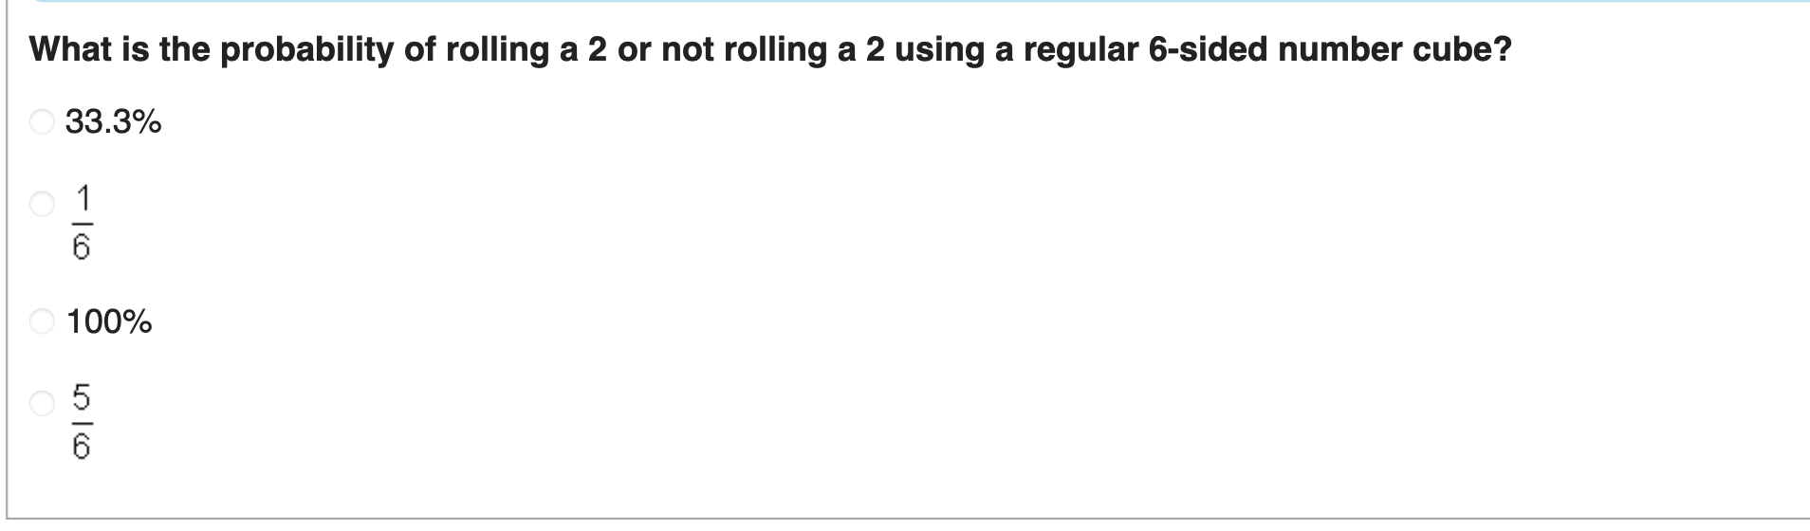
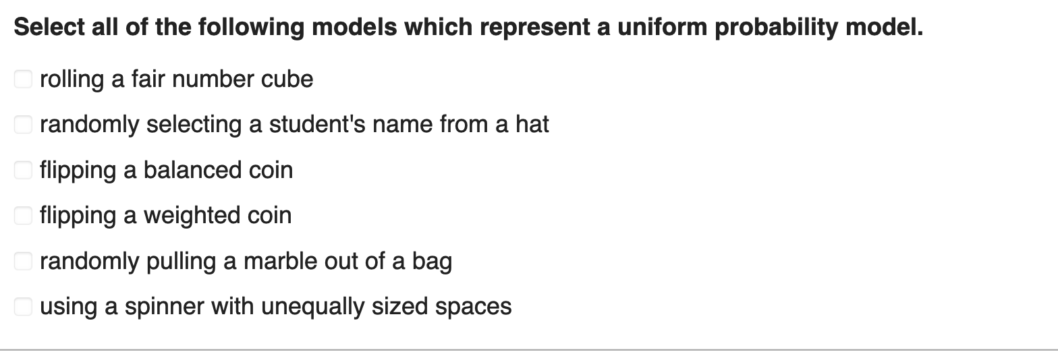

Slide 16
Experimental vs Theoretical Probability

Slide 17
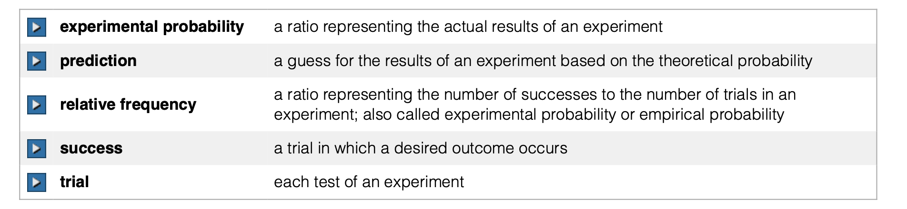

Slide 18
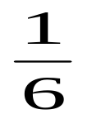
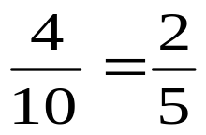
Theoretical Probability: the probability of what should happen. It’s based on a rule:
  Example: Rolling a dice and getting a 3 =
Experimental Probability: is based on an experiment; what actually happened.
  Example: Alexis rolls a strike in 4 out of 10 games. The experimental probability that she will roll a strike in the first frame of the next game is:

Slide 19
Theoretical vs Experimental Probability
Experimental
Fill in table:
What is the experimental probability of getting a Grey?
What is the experimental probability of getting a Black?
What is the experimental probability of getting a White?
Theoretical
Fill in Table:
What is the theoretical probability of getting a Grey?
What is the theoretical probability of getting Black?
What is the theoretical probability of getting a White?
Block Color | Frequency
Grey
Black
White
Block Color | Frequency
Grey
Black
White

Slide 20
Theoretical and experimental probability of an event may or may not be the same.
The more trials you perform, the closer you will get to the theoretical probability.

Slide 21
Try the Following

Slide 22
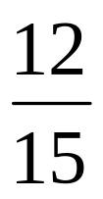
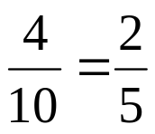
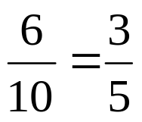


Calculate and state whether they are experimental or theoretical probabilities.
During football practice, Sam made 12 out of 15 field goals. What is the probability he will make the field goal on the next attempt?
Andy has 10 marbles in a bag. 6 are white and 4 are blue. Find the probability as a fraction, decimal, and percent of each of the following:
  P(blue marble) b. P(white marble)
Experimental
Theoretical

Slide 23

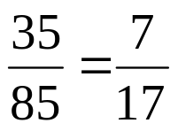
If there are 12 boys and 13 girls in a class, what is the probability that a girl will be picked to write on the board?
Ms. Beauchamp’s student have taken out 85 books from the library. 35 of them were fiction. What is the probability that the next book checked out will be a fiction book?
Theoretical
Experimental

Slide 24


What is the probability of getting a tail when flipping a coin?
Emma made 9 out of 15 foul shots during the first 3 quarters of her basketball game. What is the probability that the next time she takes a foul shot she will make it?
Theoretical
Experimental

Slide 25

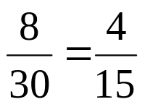
What is the probability of rolling a 4 on a die?
There are 8 black chips in a bag of 30 chips. What is the probability of picking a black chip from the bag?
Theoretical
Theoretical

Slide 26

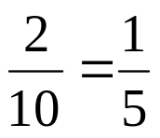
Christina scored an A on 7 out of 10 tests. What is the probability she will score an A on her next test?
There are 2 small, 5 medium, and 3 large dogs in a yard. What is the probability that the first dog to come in the door is small?
Experimental
Theoretical

Slide 27
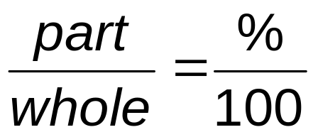
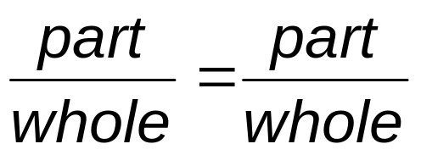
Predicting Probabilities

Slide 28
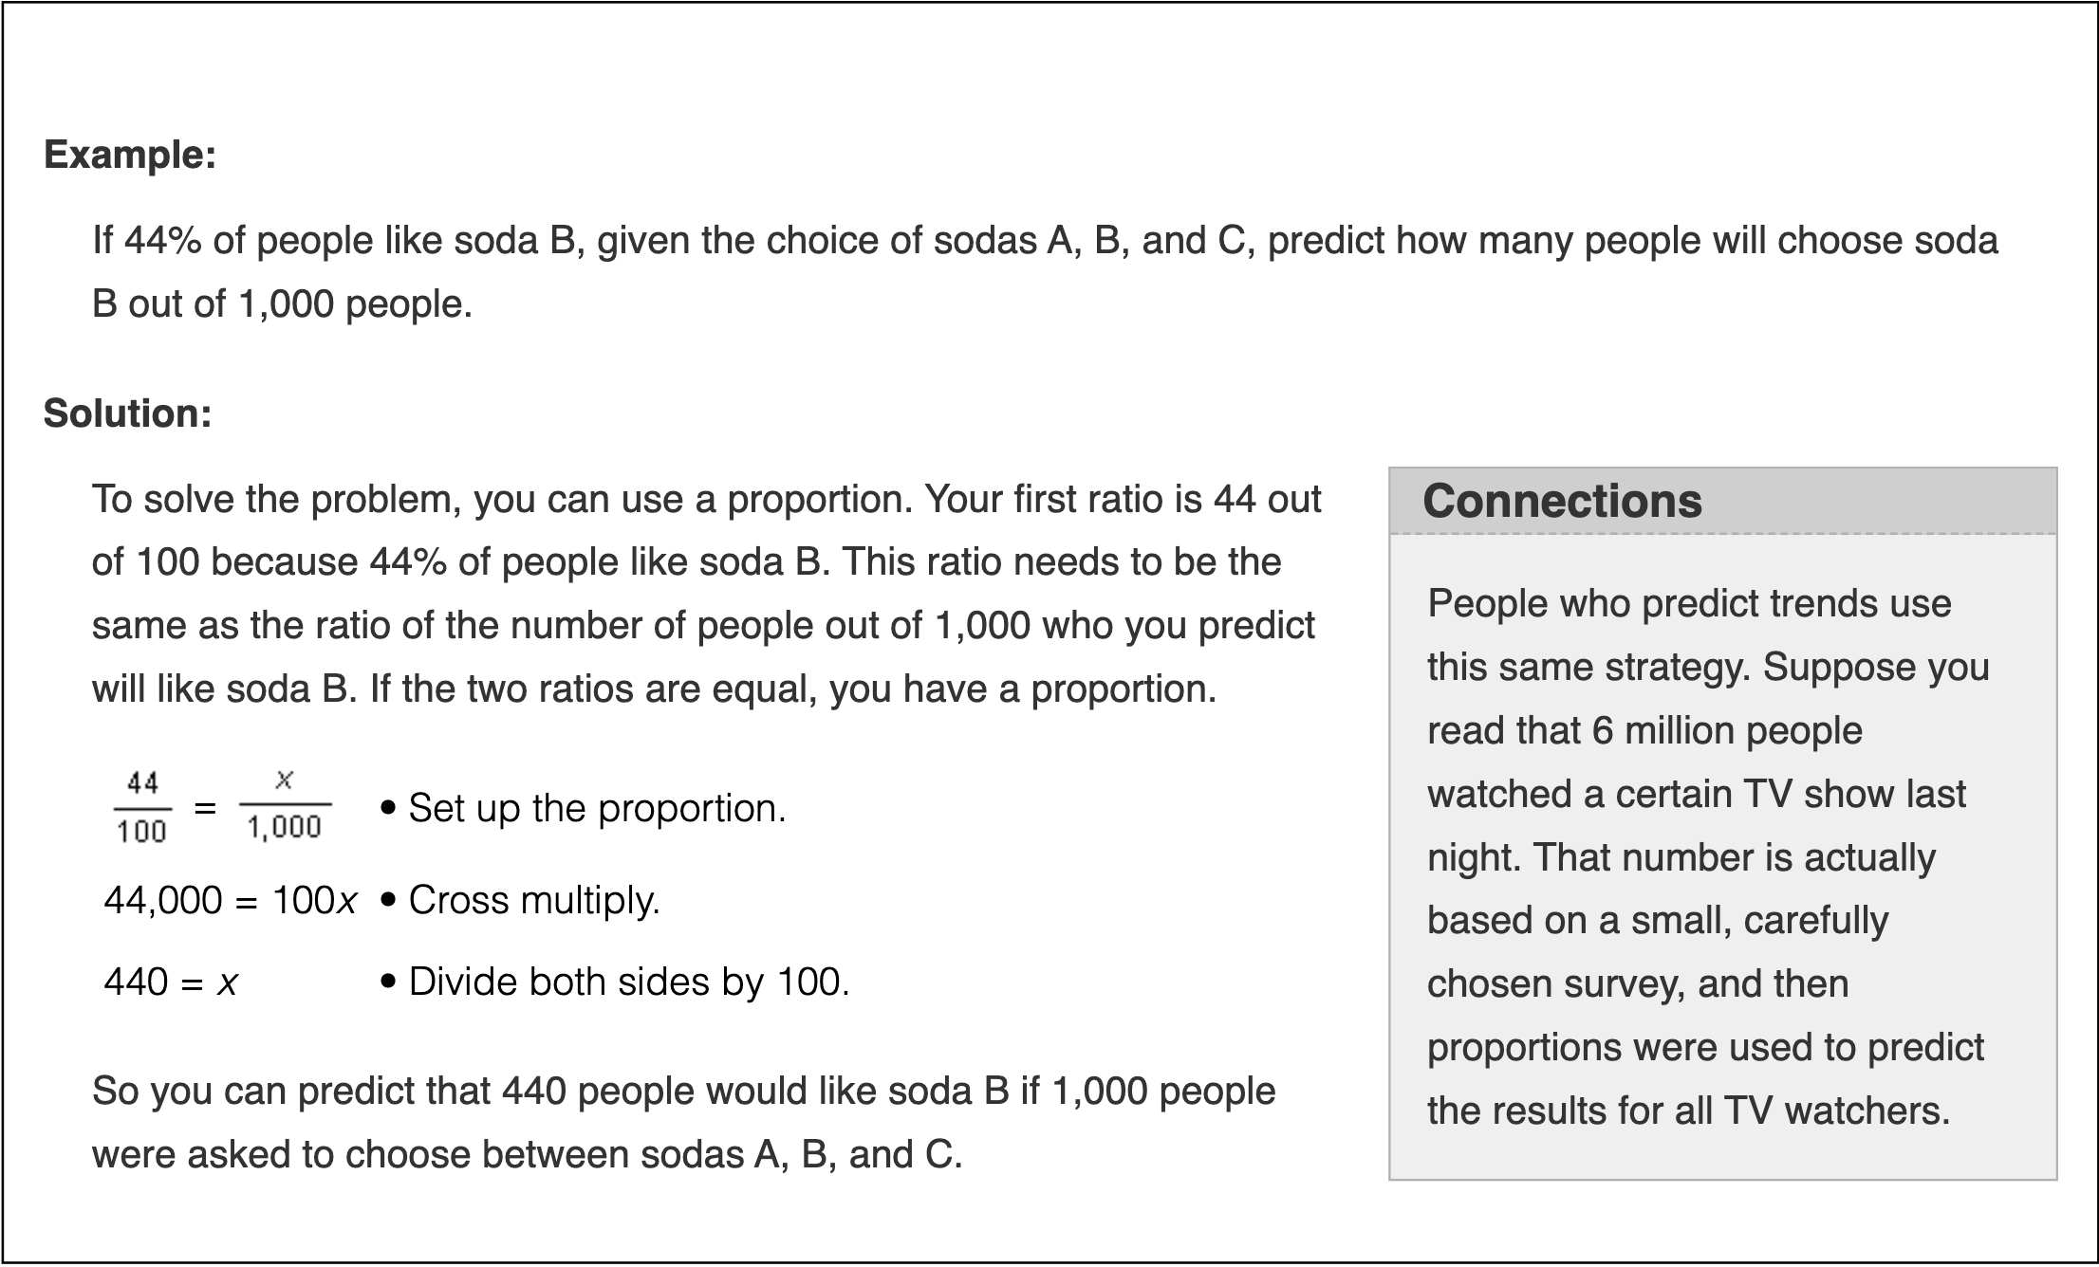

Slide 29
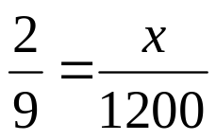
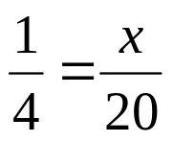
Making Predictions: Remember for predications we use proportions.
A potato chip factory rejected 2 out of 9 potatoes in an experiment. If there is a batch of 1200 potatoes going through the machine, how many potatoes are likely to be rejected?
Based on Colin’s baseball statistics, the probability that he will pitch a curveball is 1/4. If Colin throws 20 pitches, how many pitches most likely will be curveballs?
267 potatoes
5 curveballs

Slide 30
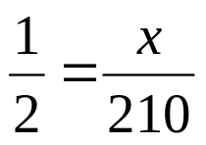
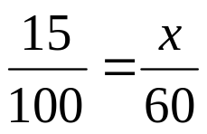
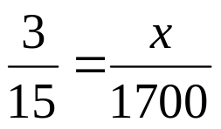
If John flips a coin 210 times about how many time should he expect the coin to land on heads?
If the historical probability that it will rain in a two month period is 15%, how many days out of 60 could you expect it to rain?
If 3 out of every 15 memory cards are defective, how many could you expect to be defective if 1700 were produced in one day?
105 times
9 days
340 memory cards

Slide 31
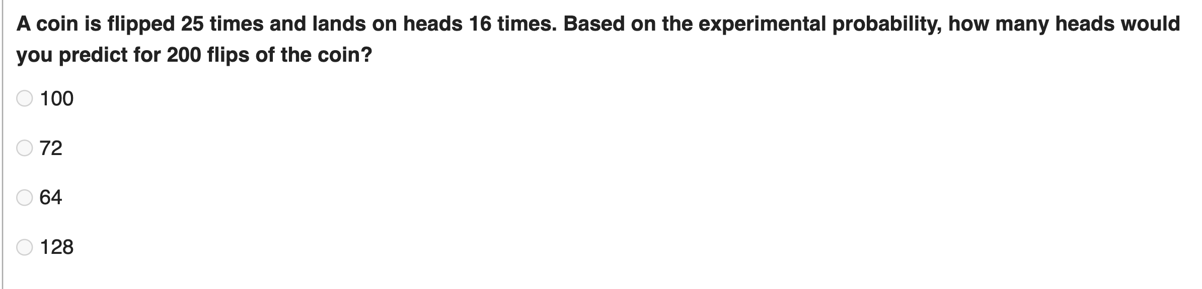
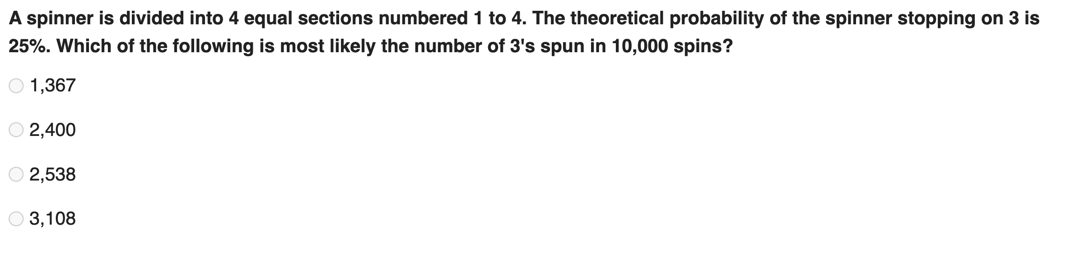
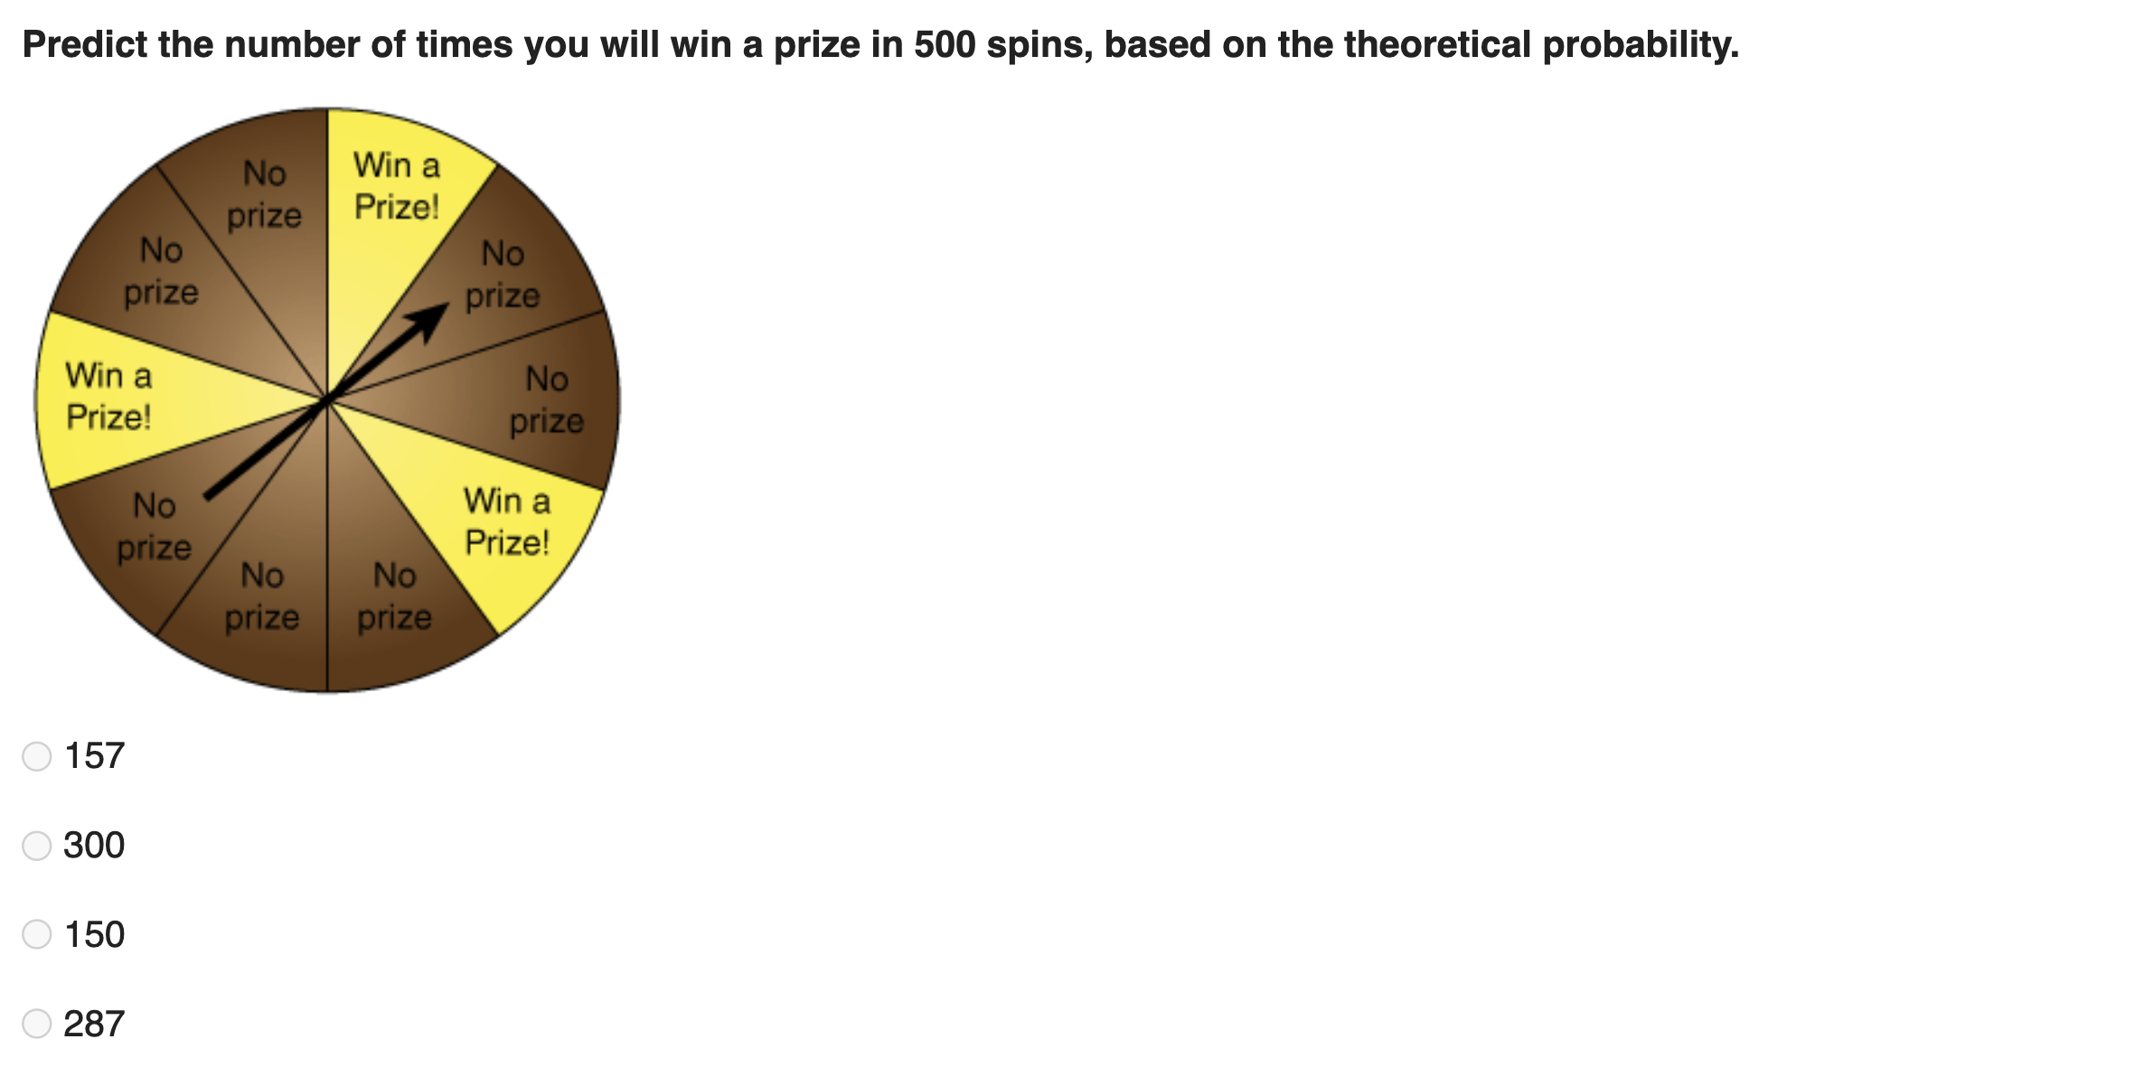

Slide 32
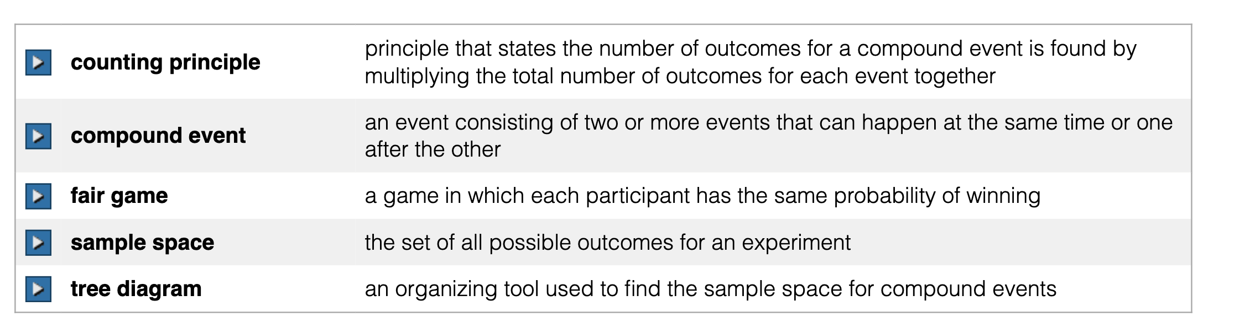
Compound Events

Slide 33
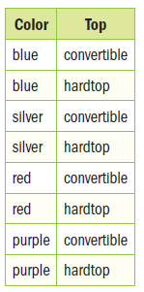
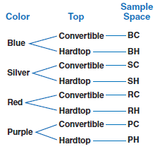
A Compound Event: is an event that consists of two or more simple events.
  Example: Rolling a die and tossing a coin.
To find the sample space of compound events we use organized lists (tables) and tree diagrams.
  Example: A car can be purchased in blue, silver, red, or purple. It also comes as a convertible or hardtop. Use a table AND a tree diagram to find the sample space for the different styles in which the car can be purchased.

Slide 34
The Fundamental Counting Principle (FCP): a way to find all the possible outcomes of an event.
  **Just multiply the number of ways each event can occur.
  Example: The counting principle for the car purchase problem above:
4 x 2 = 8 8 possible outcomes

Slide 35


‘And’ Events: This means to multiply the events.
  Example: When flipping a coin and rolling a die:
      P (heads and 1)
      P(T and odd)

Slide 36
Examples

Slide 37

Suppose you toss a quarter, a dime, and a nickel. What is the probability of getting three tails?
  Make a tree diagram to show the sample space:
  Use the FCP to check the total number of outcomes:
2 x 2 x 2= 8 8 possible outcomes

Slide 38

A coin is tossed twice. What is the probability that you land on heads at least once?
  Make a tree diagram to show the sample space
P (at least one H) = ¾

Slide 39






Find the probabilities of each of the following if you were to draw two cards from a 52-card deck, replacing the cards after you pick them.
  P(Jack and 2)
  P(Ace or 5)
  P(King of hearts and red 2)
  P(Jack and 14)
  P(King or 12)
  P(red Queen or 5)

Slide 40

















List the sample space for rolling two six-sided dice and their sums. Then calculate the following probabilities:
    P(3 or 4)
    P(at least one odd)
    P(doubles)
    P(1 and 6)
    P(sum of 5)
    P(sum of at most 4)

Slide 41

Peter has 6 sweatshirts, 4 pairs of jeans, and 3 pairs of shoes. How many different outfits can Peter make using one sweatshirt, one pair of jeans, and one pair of shoes?
A) 13 B) 36 C) 72 D) 144
For the lunch special at Nick’s Deli, customers can create their own sandwich by selecting one type of bread and one type of meat from the selection below.
  In the space below, list all the possible sandwich combinations using 1 type of bread and 1 type of meat.
  If Nick decides to add whole wheat bread as another option, how many possible sandwich combinations will there be?
WC RC
WRb RRb
6

Slide 42
Independent & Dependent Events

Slide 43
Suppose you have a bag of with 4 red, 5 blue & 9 yellow marbles in it.
From the first bag, you reach in and make a selection. You record the color and then drop the marble back into the bag. You repeat the experiment a second time.
  This experiment involves a process called with replacement. You put the object back into the bag so that the number of marbles to choose from is the same for both draws. Independent Event.

Slide 44
Suppose you have a bag of with 4 red, 5 blue & 9 yellow marbles in it.
From the second bag you do exactly the same thing EXCEPT, after you select the first marble and record it's color, you do NOT put the marble back into the bag. You then select a second marble, just like the other experiment.
  This experiment involves a process called without replacement You do not put the object back in the bag so that the number of marbles is one less than for the first draw. Dependent Event
  As you might imagine, the probabilities for the two experiments will not be the same.

Slide 45
An Independent Event: is an event whose outcome is not affected by another event.
  Example: Rolling a die & flipping a coin
  With Replacement
An Dependent Event: is an event whose outcome is affected by a prior event
  Example: pulling two marbles out of a bag at the same time
  Without Replacement
“Is this problem with replacement?”
OR
“Is this problem without replacement?”

Slide 46
Try the following

Slide 47

A player is dealt two cards from a standard deck of 52 cards. What is the probability of getting a pair of aces?
  This is “without replacement” because the player was given two cards
  P(Ace, then Ace) =
***There are four aces in a deck and you assume the first card is an ace.***
**Can cross cancel with multiplication**

Slide 48

A jar contains two red and five green marbles. A marble is drawn, its color noted and put back in the jar. What is the probability that you select three green marbles?
  With replacement
  P(green, then green, then green) =

Slide 49



What is the probability of rolling a die and getting an even number on the first roll and an odd number on the second roll?
When flipping a coin and rolling a die, what is the probability of a coin landing on heads and then rolling a five on a number cube?
A bag of candy contains 4 lemon heads and 5 war heads. If Tim reaches in, takes one out and eats it, and then 20 minutes later selects another candy and its that as well, what is the probability that they were both lemon heads?
With replacement (independent)
With replacement (independent)
Without replacement (dependent)

Slide 50


Mary has 4 dimes, 3 quarters, and 7 nickels in her purse. She reaches in and pulls out a coin, only to have it slip form her fingers and fall back into her purse. She then picks another coin. What is the probability Mary picked a nickel both tries?
Michael has four oranges, seven bananas, and five apples in a fruit basket. If Michael picks a piece of fruit at random, find the probability that Michael picks two apples.
With replacement (independent)
Without replacement (dependent)

Slide 51


A man goes to work long before sunrise every morning and gets dressed in the dark. In his sock drawer he has six black and eight blue socks. What is the probability that his first pick was a black sock and his second pick was a blue sock?
Sam has five $1 bills, three $10 bills, and two $20 bills in her wallet. She picks two bills at random. What is the probability of her picking the two $20 bills?
Without replacement (dependent)
Without replacement (dependent)

Slide 52


A drawer contains 3 red paperclips, 4 green paperclips, and 5 blue paperclips. One paperclip is taken from the drawer and then replaced. Another paperclip is taken from the drawer. What is the probability that the first paperclip is red and the second paperclip is blue?
A bag contains 3 blue and 5 red marbles. Find the probability of drawing 2 blue marbles in a row without replacing the first marble.
With replacement (independent)
Without replacement (dependent)

Slide 53
Simulations

Slide 54
An Simulation: is an experiment that is designed to act out a give event.
  Example: Use a calculator to simulate rolling a number cube
  Simulations often use models to act out an event that would be impractical to perform.

Slide 55
Try the following

Slide 56

In football, many factors are used to evaluate how good a quarterback is. One important factor is the ability to complete passes. If a quarterback has a completion percent of 64%, he completes about 64 out of 100 passes he throws. What is the probability that he will complete at least 6 of 10 passes thrown? A simulation can help you estimate this probability…
  In a set of random numbers, each number has the same probability of occurring, and no pattern can be used to predict the next number. Random numbers can be used to simulate events. Below is a set of 100 random digits.
  Since the probability that the quarterback completes a pass is 64% (or 0.64), use the digits from the table to model the situation. The numbers 1-64 represent a completed pass and the numbers 65-00 represent an incomplete pass. Each group of 20 digits represents one trial.

Slide 57
  In the first trial (the first row of the table) circle the completed passes.
  How many passes were completed in this trial?
  Continue using the chart to circle the completed passes. Based on this simulation what is the probability of completing at least 6 out of 10 passes?
6
7/10
6
7
7
6
5
8
7
7
4
5

Slide 58


A cereal company is placing one of eight different trading cards in its boxes of cereal. If each card is equally likely to appear in a box of cereal, describe a model that could be used to simulate the cards you would find in fifteen boxes of cereal.
  Choosing a method that has 8 possible outcomes, such as tossing 3 coins. Let each outcome represent a different card. For example, the outcome of all three coins landing on heads could simulate finding card #1.
  Toss three coins to simulate the cards that might be in 15 boxes of cereal. How many times would you have to repeat?
15 times

Slide 59
A restaurant is giving away 1 of 5 different toys with its children’s meals. If the toys are given out randomly, describe a model that could be used to simulate which toys would be given with 6 children’s meals.
Use a spinner with 5 equal sections, spin it 6 times

